Slide 1
Navs & tabs
Taught by Yossef Ayman Zedan

Slide 2
Base nav
Navigation available in Bootstrap share general markup and styles, from the base .nav class to the active and disabled states. Swap modifier classes to switch between each style.
The base .nav component is built with flexbox and provide a strong foundation for building all types of navigation components. It includes some style overrides (for working with lists), some link padding for larger hit areas, and basic disabled styling.
The base .nav component does not include any .active state. The following examples include the class, mainly to demonstrate that this particular class does not trigger any special styling.

Slide 3
Base nav
<ul class="nav">
<li class="nav-item">
<a class="nav-link active" href="#">Active</a>
</li>
<li class="nav-item">
<a class="nav-link" href="#">Link</a>
</li>
<li class="nav-item">
<a class="nav-link" href="#">Link</a>
</li>
<li class="nav-item">
<a class="nav-link disabled" href">Disabled</a>
</li>
</ul>

Slide 4
Base nav
Classes are used throughout, so your markup can be super flexible. Use <ul>s like above, <ol> if the order of your items is important, or roll your own with a <nav> element. Because the .nav uses display: flex, the nav links behave the same as nav items would, but without the extra markup.

Slide 5
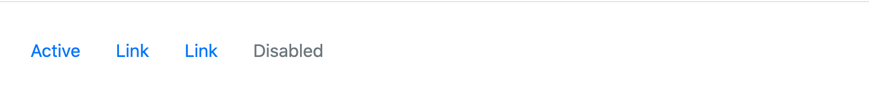
Base nav
<nav class="nav">
<a class="nav-link active" href="#">Active</a>
<a class="nav-link" href="#">Link</a>
<a class="nav-link" href="#">Link</a>
<a class="nav-link disabled" href=#”>Disabled</a>
</nav>

Slide 6

Horizontal alignment
Change the horizontal alignment of your nav with flexbox utilities. By default, navs are left-aligned, but you can easily change them to center or right aligned.
Centered with .justify-content-center:

Slide 7
Horizontal alignment
<ul class="nav justify-content-center">
<li class="nav-item">
<a class="nav-link active" href="#">Active</a>
</li>
<li class="nav-item">
<a class="nav-link" href="#">Link</a>
</li>
<li class="nav-item">
<a class="nav-link" href="#">Link</a>
</li>
<li class="nav-item">
<a class="nav-link disabled" href="#">Disabled</a>
</li>
</ul>

Slide 8
Horizontal alignment
Right-aligned with .justify-content-end:

Slide 9
Horizontal alignment
<ul class="nav justify-content-end">
<li class="nav-item">
<a class="nav-link active" href="#">Active</a>
</li>
<li class="nav-item">
<a class="nav-link" href="#">Link</a>
</li>
<li class="nav-item">
<a class="nav-link" href="#">Link</a>
</li>
<li class="nav-item">
<a class="nav-link disabled" href="#" >Disabled</a>
</li>
</ul>

Slide 10
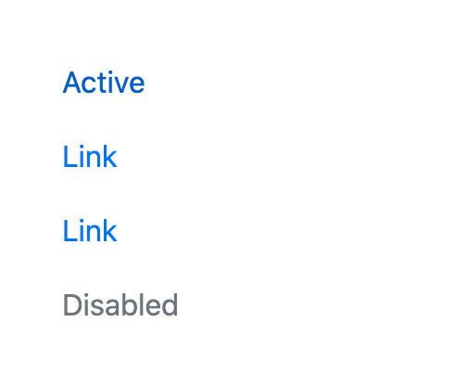
Vertical
Stack your navigation by changing the flex item direction with the .flex-column utility. Need to stack them on some viewports but not others? Use the responsive versions (e.g., .flex-sm-column).

Slide 11
Vertical
<ul class="nav flex-column">
<li class="nav-item">
<a class="nav-link active" href="#">Active</a>
</li>
<li class="nav-item">
<a class="nav-link" href="#">Link</a>
</li>
<li class="nav-item">
<a class="nav-link" href="#">Link</a>
</li>
<li class="nav-item">
<a class="nav-link disabled" href="#" ">Disabled</a>
</li>
</ul>

Slide 12
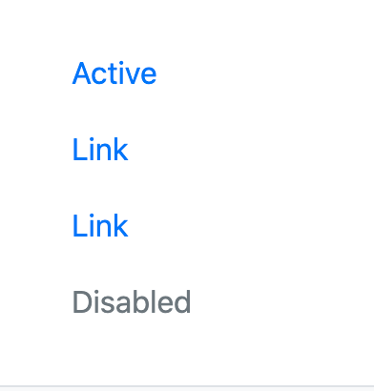
Vertical
As always, vertical navigation is possible without <ul>s, too.

Slide 13
Vertical
<nav class="nav flex-column">
<a class="nav-link active" href="#">Active</a>
<a class="nav-link" href="#">Link</a>
<a class="nav-link" href="#">Link</a>
<a class="nav-link disabled" href="#">Disabled</a>
</nav>

Slide 14
Tabs
Takes the basic nav from above and adds the .nav-tabs class to generate a tabbed interface
<ul class="nav nav-tabs">
<li class="nav-item">
<a class="nav-link active" href="#">Active</a>
</li>
<li class="nav-item">
<a class="nav-link" href="#">Link</a>
</li>
<li class="nav-item">
<a class="nav-link" href="#">Link</a>
</li>
<li class="nav-item">
<a class="nav-link disabled" href="#" >Disabled</a>
</li>
</ul>

Slide 15
Tabs

Slide 16
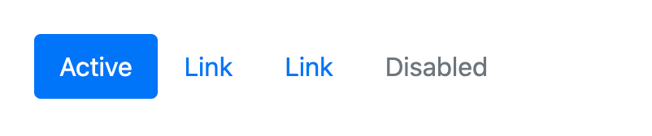
Pills
Take that same HTML, but use .nav-pills instead:
<ul class="nav nav-pills"> </ul>

Slide 17
Fill and justify
Force your .nav’s contents to extend the full available width one of two modifier classes. To proportionately fill all available space with your .nav-items, use .nav-fill. Notice that all horizontal space is occupied, but not every nav item has the same width.

Slide 18
Fill and justify
<ul class="nav nav-pills nav-fill">
<li class="nav-item">
<a class="nav-link active" href="#">Active</a>
</li>
<li class="nav-item">
<a class="nav-link" href="#">Much longer nav link</a>
</li>
<li class="nav-item">
<a class="nav-link" href="#">Link</a>
</li>
<li class="nav-item">
<a class="nav-link disabled" href="#">Disabled</a>
</li>
</ul>

Slide 19
Fill and justify
When using a <nav>-based navigation, you can safely omit .nav-item as only .nav-link is required for styling <a> elements.
<nav class="nav nav-pills nav-fill">
<a class="nav-link active" href="#">Active</a>
<a class="nav-link" href="#">Much longer nav link</a>
<a class="nav-link" href="#">Link</a>
<a class="nav-link disabled" href="#">Disabled</a>
</nav>

Slide 20
Fill and justify
For equal-width elements, use .nav-justified. All horizontal space will be occupied by nav links, but unlike the .nav-fill above, every nav item will be the same width.
<ul class="nav nav-pills nav-justified">
<li class="nav-item">
<a class="nav-link active" href="#">Active</a>
</li>
<li class="nav-item">
<a class="nav-link" href="#">Much longer nav link</a>
</li>
<li class="nav-item">
<a class="nav-link" href="#">Link</a>
</li>
<li class="nav-item">
<a class="nav-link disabled" href="#">Disabled</a>
</li>
</ul>

Slide 21
Fill and justify
For equal-width elements, use .nav-justified. All horizontal space will be occupied by nav links, but unlike the .nav-fill above, every nav item will be the same width.
<ul class="nav nav-pills nav-justified">
<li class="nav-item">
<a class="nav-link active" href="#">Active</a>
</li>
<li class="nav-item">
<a class="nav-link" href="#">Much longer nav link</a>
</li>
<li class="nav-item">
<a class="nav-link" href="#">Link</a>
</li>
<li class="nav-item">
<a class="nav-link disabled" href="#">Disabled</a>
</li>
</ul>

Slide 22
Fill and justify
Similar to the .nav-fill example using a <nav>-based navigation.
<nav class="nav nav-pills nav-justified">
<a class="nav-link active" href="#">Active</a>
<a class="nav-link" href="#">Much longer nav link</a>
<a class="nav-link" href="#">Link</a>
<a class="nav-link disabled" href="#">Disabled</a>
</nav>

Slide 23
Working with flex utilities
If you need responsive nav variations, consider using a series of flexbox utilites. While more verbose, these utilities offer greater customization across responsive breakpoints. In the example below, our nav will be stacked on the lowest breakpoint, then adapt to a horizontal layout that fills the available width starting from the small breakpoint.
<nav class="nav nav-pills flex-column flex-sm-row">
<a class="flex-sm-fill text-sm-center nav-link active" href="#">Active</a>
<a class="flex-sm-fill text-sm-center nav-link" href="#">Longer nav link</a>
<a class="flex-sm-fill text-sm-center nav-link" href="#">Link</a>
<a class="flex-sm-fill text-sm-center nav-link disabled" href="#">Disabled</a>
</nav>

Slide 24
Regarding accessibility
If you’re using navs to provide a navigation bar, be sure to add a role="navigation" to the most logical parent container of the <ul>, or wrap a <nav> element around the whole navigation. Do not add the role to the <ul> itself, as this would prevent it from being announced as an actual list by assistive technologies.

Slide 25
Tabs with dropdowns
If you’re using navs to provide a navigation bar, be sure to add a role="navigation" to the most logical parent container of the <ul>, or wrap a <nav> element around the whole navigation. Do not add the role to the <ul> itself, as this would prevent it from being announced as an actual list by assistive technologies.
<li class="nav-item dropdown">
<a class="nav-link dropdown-toggle" data-bs-toggle="dropdown" href="#" role="button">Dropdown</a>
<ul class="dropdown-menu">
<li><a class="dropdown-item" href="#">Action</a></li>
<li><a class="dropdown-item" href="#">Another action</a></li>
<li><a class="dropdown-item" href="#">Something else here</a></li>
<li><hr class="dropdown-divider"></li>
<li><a class="dropdown-item" href="#">Separated link</a></li>
</ul>
</li>

Slide 26
JavaScript behavior
<ul class="nav nav-tabs" id="myTab" role="tablist">
<li class="nav-item" role="presentation">
<button class="nav-link active" id="home-tab" data-bs-toggle="tab" data-bs-target="#home" type="button" role="tab">Home</button>
</li>
<li class="nav-item" role="presentation">
<button class="nav-link" id="profile-tab" data-bs-toggle="tab" data-bs-target="#profile" type="button" role="tab">Profile</button>
</li>
<li class="nav-item" role="presentation">
<button class="nav-link" id="contact-tab" data-bs-toggle="tab" data-bs-target="#contact" type="button" role="tab">Contact</button>
</li>
</ul>

Slide 27
JavaScript behavior
<div class="tab-content" id="myTabContent">
<div class="tab-pane fade show active" id="home" role="tabpanel" aria-labelledby="home-tab">...</div>
<div class="tab-pane fade" id="profile" role="tabpanel" aria-labelledby="profile-tab">...</div>
<div class="tab-pane fade" id="contact" role="tabpanel" aria-labelledby="contact-tab">...</div>
</div>

Slide 28
JavaScript behavior
To help fit your needs, this works with <ul>-based markup, as shown above, or with any arbitrary “roll your own” markup. Note that if you’re using <nav>, you shouldn’t add role="tablist" directly to it, as this would override the element’s native role as a navigation landmark. Instead, switch to an alternative element (in the example below, a simple <div>) and wrap the <nav> around it.

Slide 29
JavaScript behavior
<nav>
<div class="nav nav-tabs" id="nav-tab" role="tablist">
<button class="nav-link active" id="nav-home-tab" data-bs-toggle="tab" data-bs-target="#nav-home" type="button" role="tab">Home</button>
<button class="nav-link" id="nav-profile-tab" data-bs-toggle="tab" data-bs-target="#nav-profile" type="button" role="tab">Profile</button>
<button class="nav-link" id="nav-contact-tab" data-bs-toggle="tab" data-bs-target="#nav-contact" type="button" role="tab">Contact</button>
</div>
</nav>
<div class="tab-content" id="nav-tabContent">
<div class="tab-pane fade show active" id="nav-home" role="tabpanel">...</div>
<div class="tab-pane fade" id="nav-profile" role="tabpanel">...</div>
<div class="tab-pane fade" id="nav-contact" role="tabpanel">...</div>
</div>

Slide 30
JavaScript behavior
The tabs plugin also works with pills.
<ul class="nav nav-pills mb-3" id="pills-tab" role="tablist"> </ul>

Slide 31
JavaScript behavior
And with vertical pills.
<div class="d-flex align-items-start">
<div class="nav flex-column nav-pills me-3" id="v-pills-tab" role="tablist">
<button class="nav-link active" id="v-pills-home-tab" data-bs-toggle="pill" data-bs-target="#v-pills-home" type="button" role="tab">Home</button>
<button class="nav-link" id="v-pills-profile-tab" data-bs-toggle="pill" data-bs-target="#v-pills-profile" type="button" role="tab">Profile</button>
<button class="nav-link" id="v-pills-messages-tab" data-bs-toggle="pill" data-bs-target="#v-pills-messages" type="button" role="tab">Messages</button>
<button class="nav-link" id="v-pills-settings-tab" data-bs-toggle="pill" data-bs-target="#v-pills-settings" type="button" role="tab">Settings</button>
</div>

Slide 32
JavaScript behavior
<div class="tab-content" id="v-pills-tabContent">
<div class="tab-pane fade show active" id="v-pills-home" role="tabpanel" aria-labelledby="v-pills-home-tab">...</div>
<div class="tab-pane fade" id="v-pills-profile" role="tabpanel" aria-labelledby="v-pills-profile-tab">...</div>
<div class="tab-pane fade" id="v-pills-messages" role="tabpanel" aria-labelledby="v-pills-messages-tab">...</div>
<div class="tab-pane fade" id="v-pills-settings" role="tabpanel" aria-labelledby="v-pills-settings-tab">...</div>
</div>
</div>

